Slide 1

Inside the Numbers aka
“Hamster Wheel Journalism”

Slide 2
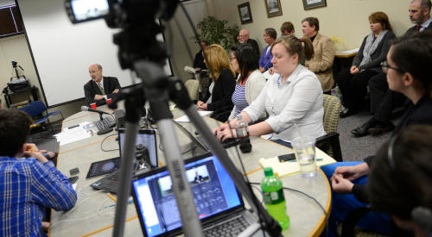
The Morning News Meeting: Past

Slide 3
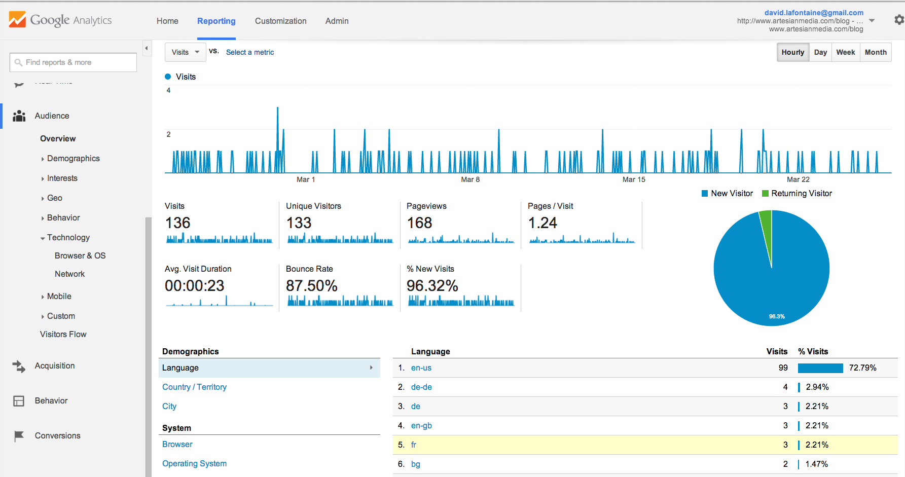
The Morning News Meeting: Now

Slide 4
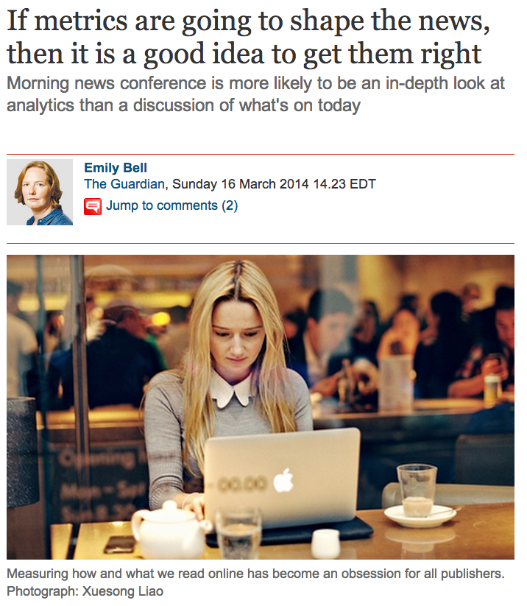

Slide 5
Attention in the virtual world is like money in the real world; the very presence of it attracts more of the same, producing what might seem like gross iniquities.
A cat falling off a sofa is less important than riots in Venezuela, yet we can now see how our attention goes to one not the other. Measuring how and what we read online has become an obsession for all publishers.

Slide 6
The abundance of possible metrics now available to publishers is not necessarily helping either.
Using NSA-style techniques (although naturally much more benignly), the Guardian or any other publisher can track every movement you make on an online piece, where you come from, where you go to, whether you are actively reading or whether you have tuned out.

Slide 7
These metrics form themselves into the basis of advertising sales and increasingly inform editorial decisions too.
Morning news conference is more likely to be an in-depth look at analytics than a discussion of "what's on today" at the most sophisticated news companies.

Slide 8
Another example…

Slide 9
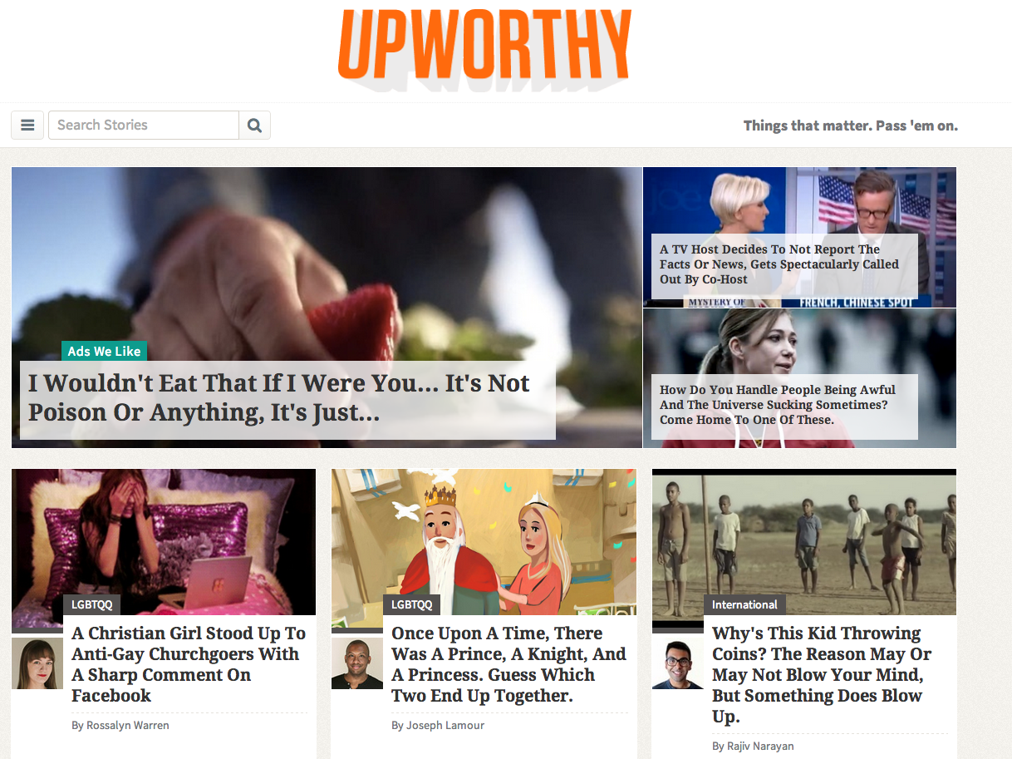

Slide 10
Upworthy is one of the fastest growing news websites in the world right now, fuelled by its stream of stories designed to be shared on social networks.
Upworthy’s key metrics have shifted away from measuring unique visitors and page views to something called “attention minutes” according to Pariser.

Slide 11
“It’s trying to look at our content the way an algorithm would see it. Are people sticking with it? Do we know that people are still there, or are people walking out of the room?” he said.
“For a long time that’s been something that’s bad to do... an affront to your editorial authority.”

Slide 12
“…if a journalist spends weeks writing an investigative piece, that gets buried in the newspaper or website and that nobody reads, that doesn’t accomplish the “civic mission” that it was intended to fulfill.”

Slide 13
… one of his first big viral stories at the MoveOn website: a video of a young man talking about his two gay mothers, explaining passionately why they shouldn’t be discriminated against.
It had been watched 200,000 times or so, but once its headline was changed to “Two Lesbians Raised A Baby And This Is What They Got” from its original “Zach Wahls Speaks About Family” the video took off – it’s since been watched more than 18.4m times.
Read the rest of this: http://www.theguardian.com/technology/2014/mar/10/upworthy-viral-news-sxsw-eli-pariser

Slide 14
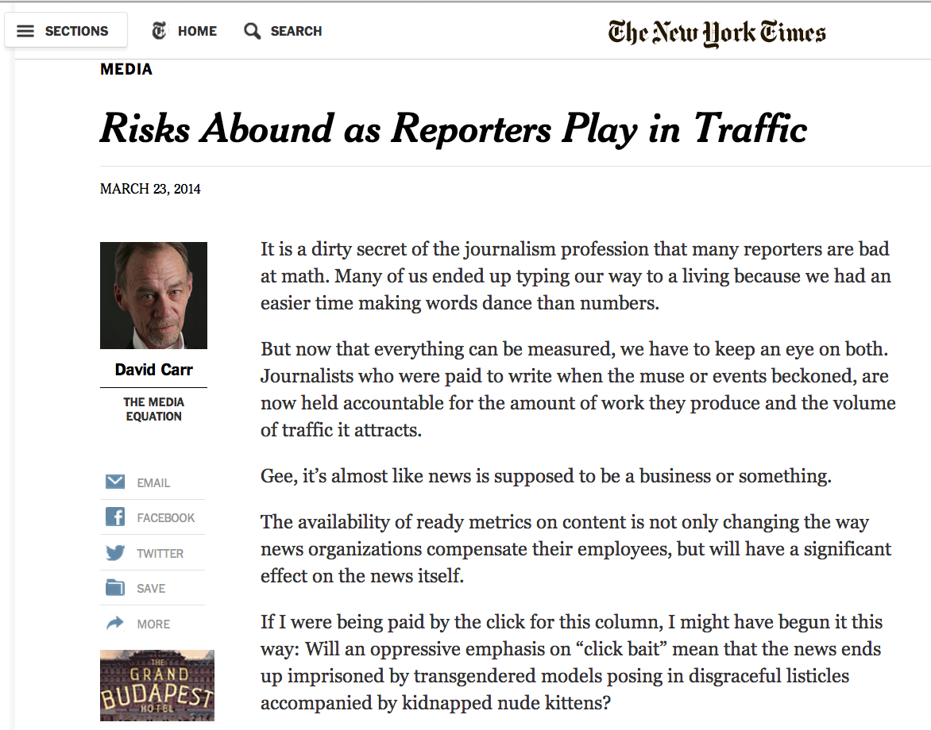
The New York Times weighs in

Slide 15
Joel Johnson, the editorial director of Gawker Media, announced a program in February called “Recruits” that creates subsidiary sites for new contributors, attached to existing editorial sites like Gawker or Jezebel. The recruits receive a stipend of $1,500 a month, and pay back that amount at a rate of $5 for every 1,000 unique visitors they attract. They then get to keep anything above the amount of the stipend, up to $6,000.
At the end of 90 days, the contributors are evaluated and retained or cut loose based on their traffic performance.
Read this article: http://www.nytimes.com/2014/03/24/business/media/risks-abound-as-reporters-play-in-traffic.html?pagewanted=all&_r=0

Slide 16
What could go wrong?

Slide 17




Years ago, I did a case study…

Slide 18
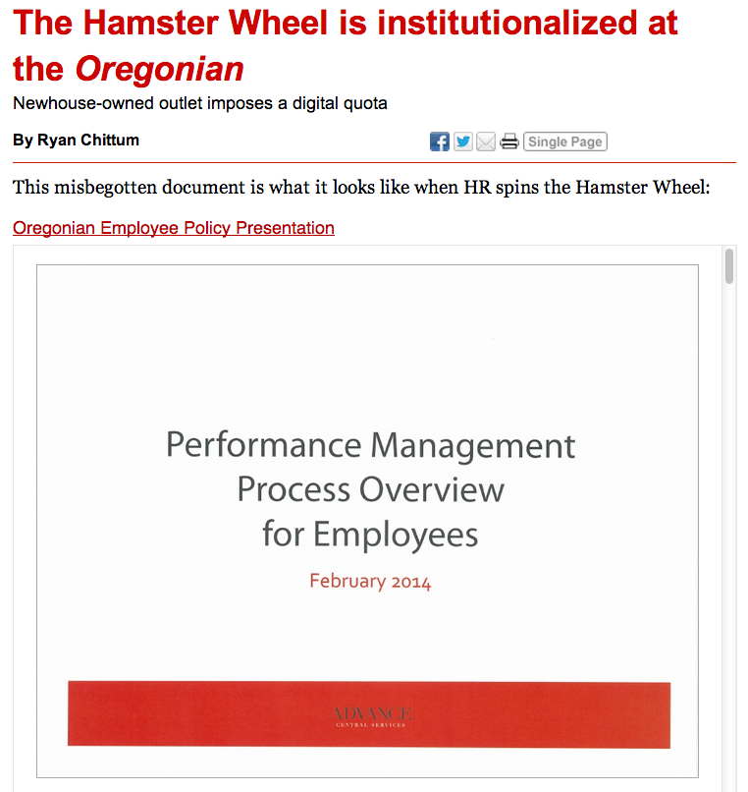

Slide 19
Let’s take a closer look, shall we?
http://www.cjr.org/the_audit/the_oregonian_bureaucratizes_t.php

Slide 20
Assignments – Part 1
Write me an 400-word analysis of this question:
Do our readers really want trash?
Why? Why not?
What can/should journalists do in the face of market imperatives?
Cite me two (2) links to websites that support your argument

Slide 21
Assignment: Part 2 – Driving traffic
Upload your animated infographic to the DigitalJournos site.
2. Put this code in the <head> section, ie
<head> <script>
(function(i,s,o,g,r,a,m){i['GoogleAnalyticsObject']=r;i[r]=i[r]||function(){ (i[r].q=i[r].q||[]).push(arguments)},i[r].l=1*new Date();a=s.createElement(o),
m=s.getElementsByTagName(o)[0];a.async=1;a.src=g;m.parentNode.insertBefore(a,m)
})(window,document,'script','//www.google-analytics.com/analytics.js','ga');
ga('create', 'UA-6265550-2', 'digitaljournos.com');
ga('send', 'pageview');
</script> </head>

Slide 22
Assignment 2 – Driving Traffic
3. Register for a bit.ly account
4. Start driving traffic to your infographic.
Use: Facebook, Twitter, Instagram, Pinterest, Tumblr, Storify, blog posts, on-air promos … whatever.
See how well you can play this game. Learn what works.

Slide 23
You will be graded based on your traffic.
You will need this skill in the real world.

